Slide 1
Basic R Instructions

Slide 2
Installation
Download and install R
Run the “R-Libraries.R” script from the root of the github project directory

Slide 3
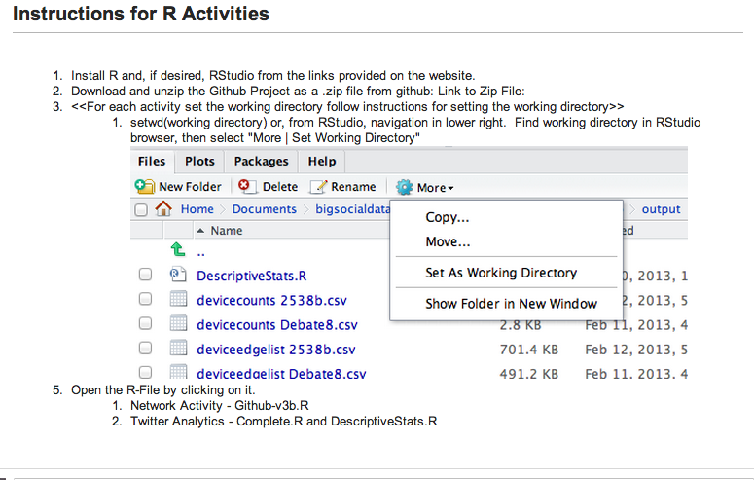
Basics

